Slide 1

Coffee Sales Data Analysis and Forecasting
Data Cleaning, Machine Learning, and Insights

Slide 2

Dataset Overview
The dataset contains daily sales data for a coffee chain.
Key features include sales, date, and seasonality patterns.

Slide 3

Data Cleaning
Stripped spaces from column names.
Renamed 'money' column to 'sales'.
Interpolated missing values using linear interpolation.

Slide 4
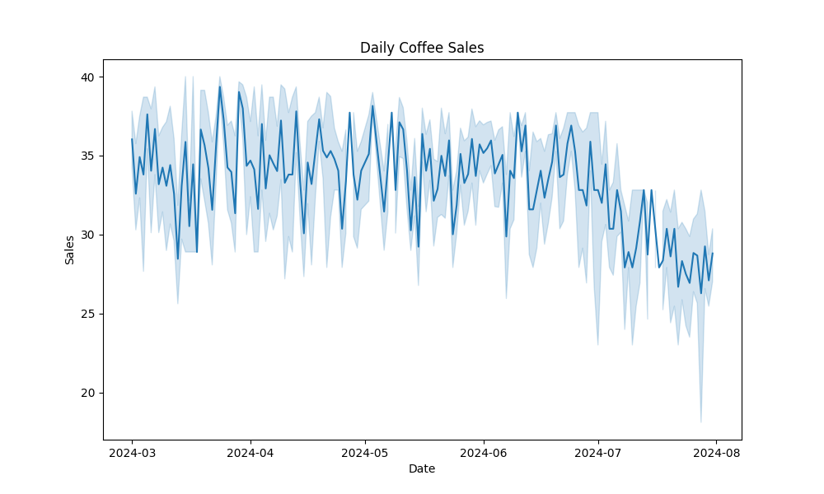
Daily Coffee Sales

Slide 5
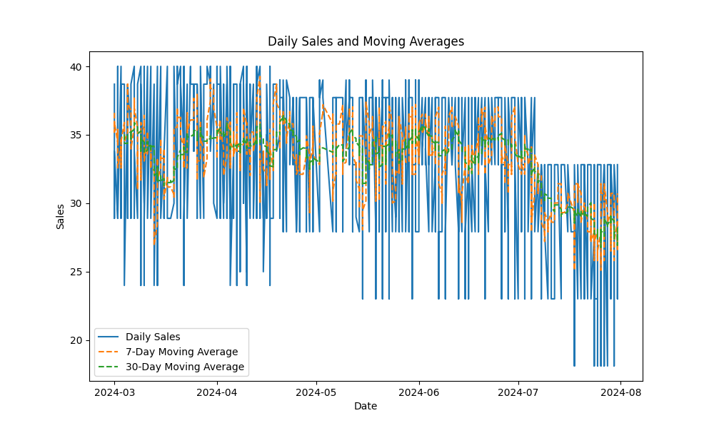
Daily Sales and Moving Averages

Slide 6
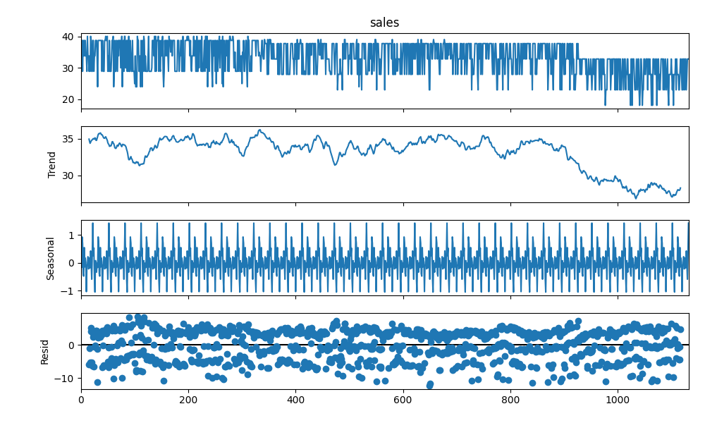
Seasonal Decomposition

Slide 7
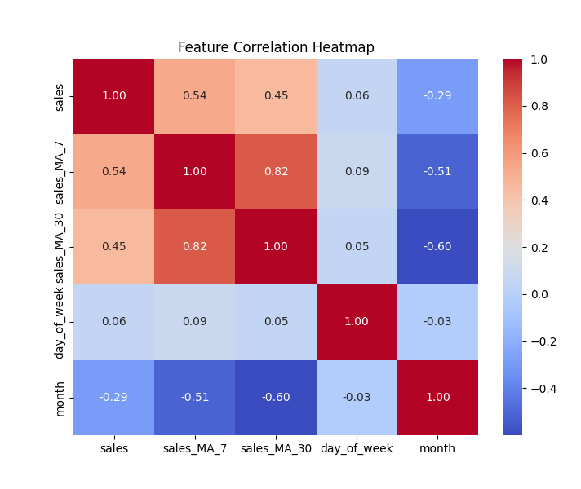
Feature Correlation Heatmap

Slide 8

Model Evaluation
Random Forest Regressor:
Mean Absolute Error: 3.96
Mean Squared Error: 24.42
Root Mean Squared Error: 4.94

